Slide 1
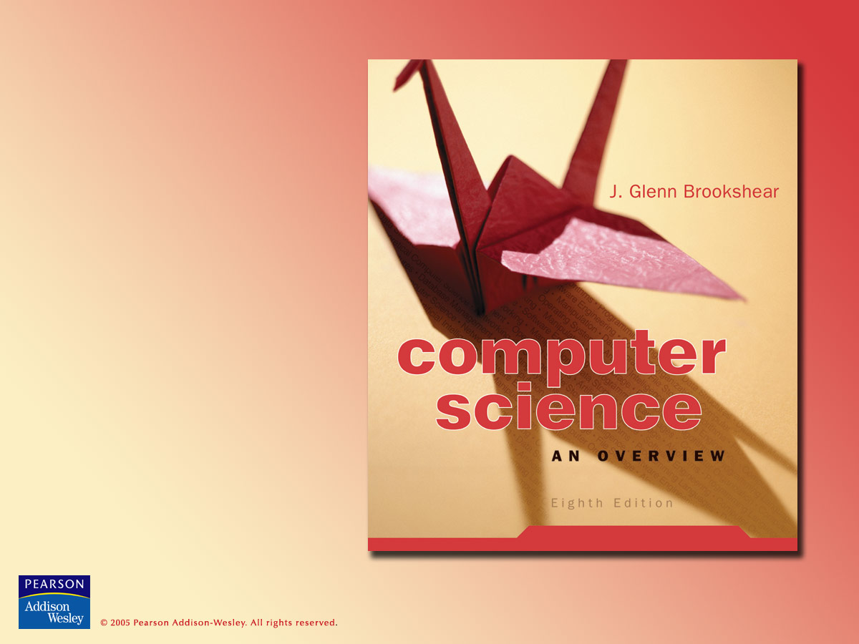
Chapter 5
Algorithms

Slide 2

Chapter 5: Algorithms
5.1 The Concept of an Algorithm
5.2 Algorithm Representation
5.3 Algorithm Discovery
5.4 Iterative Structures
5.5 Recursive Structures
5.6 Efficiency and Correctness

Slide 3
Algorithm: definition
An algorithm is an ordered set of unambiguous, executable steps that defines a terminating process.

Slide 4
Algorithms: levels of abstraction
Problem = motivation for algorithm
Algorithm = procedure to solve the problem
  Often one of many possibilities
Representation = description of algorithm sufficient to communicate it to the desired audience
  Always one of many possibilities

Slide 5
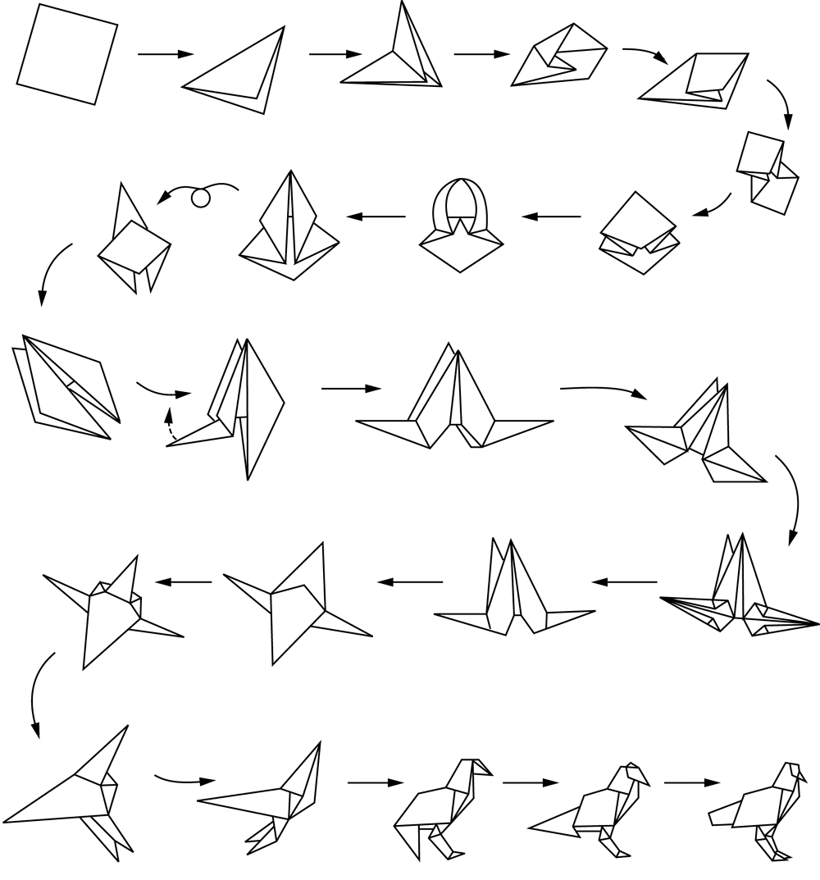
Figure 5.2 Folding a bird from a square piece of paper

Slide 6
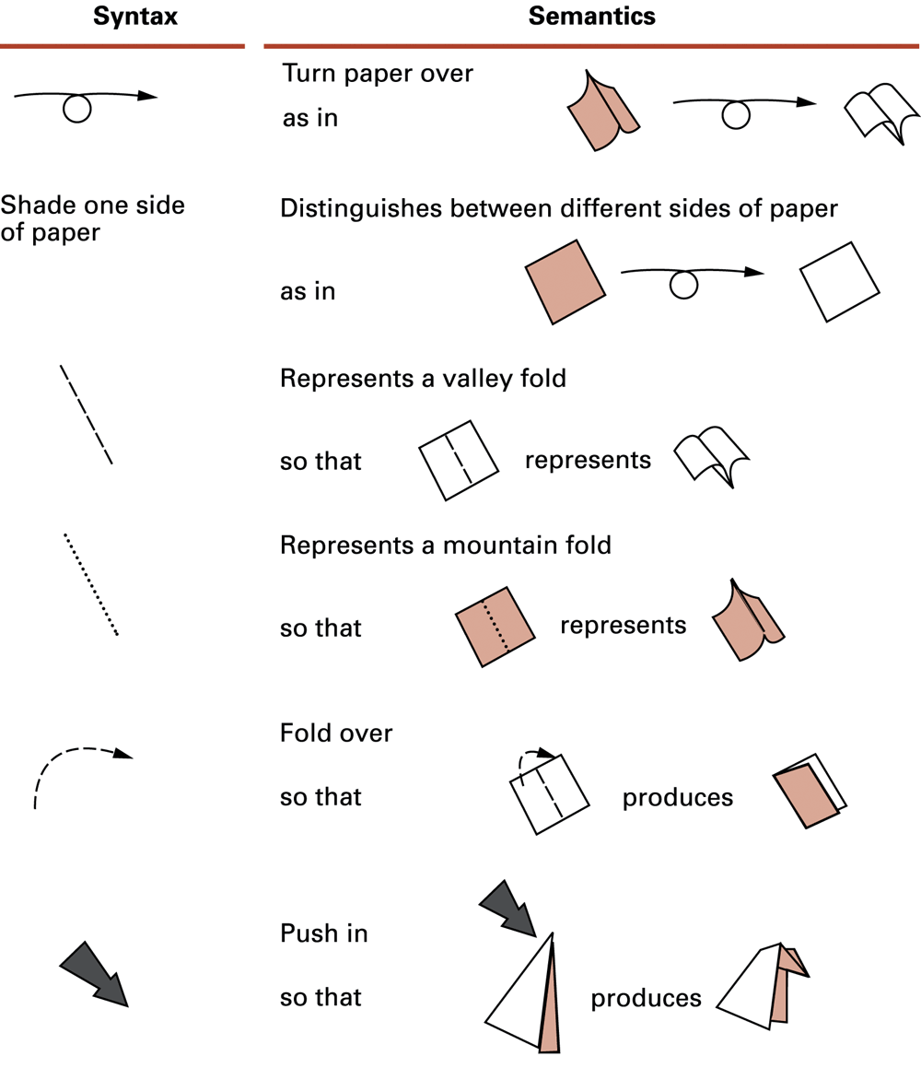
Figure 5.3 Origami primitives

Slide 7
Pseudocode primitives
Assignment name ← expression
Conditional selection if condition then action
Repeated execution while condition do activity
Procedure procedure name (generic names)

Slide 8
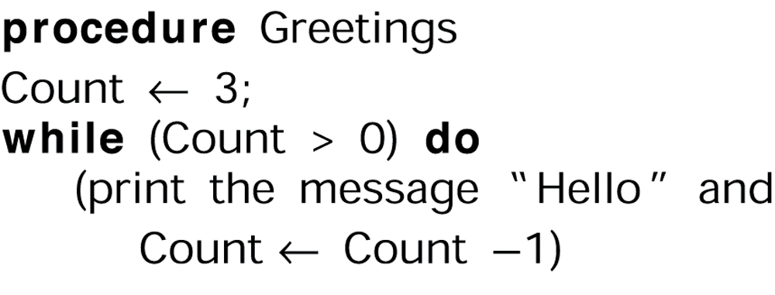
Figure 5.4 The procedure Greetings in pseudocode

Slide 9
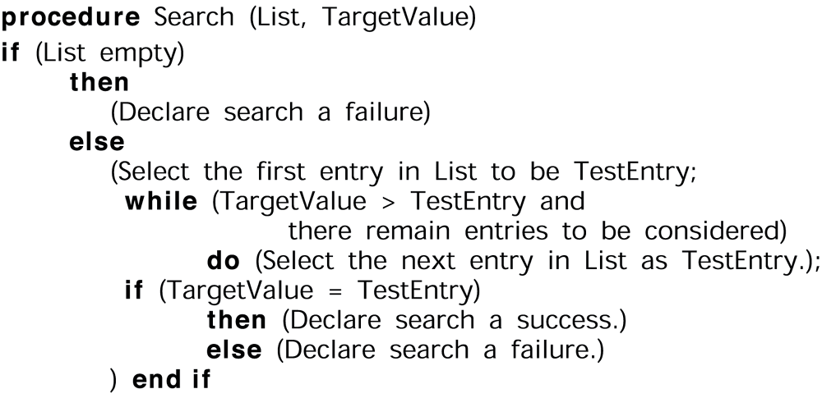
Figure 5.6 The sequential search algorithm in pseudocode

Slide 10
Problem solving steps
1. Understand the problem.
2. Get an idea how an algorithmic procedure might solve the problem.
3. Formulate the algorithm and represent it as a program.
4. Evaluate the program for accuracy and its potential as a tool for solving other problems.

Slide 11
Techniques for
“getting a foot in the door”
Work the problem backwards
Solve an easier related problem
  Relax some of the problem constraints
  Solve pieces of the problem first = bottom up methodology
Stepwise refinement = top-down methodology
  Popular technique because it produces modular programs

Slide 12
Sample problem
Person A is charged with the task of determining the ages of B’s three children.
B tells A that the product of the children’s ages is 36.
A replies that another clue is required.
B tells A the sum of the children’s ages.
A replies that another clue is needed.
B tells A that the oldest child plays the piano.
A tells B the ages of the three children.
How old are the three children?

Slide 13
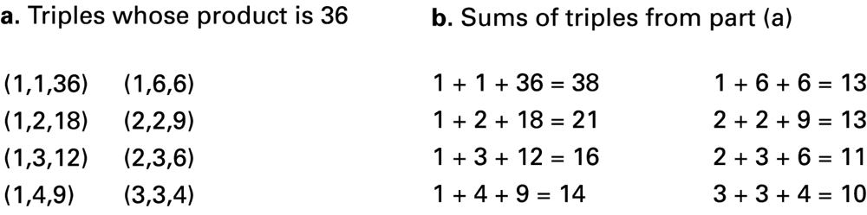
Figure 5.5

Slide 14
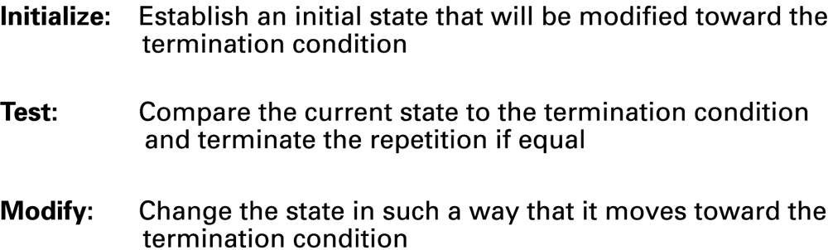
Figure 5.7 Components of repetitive control

Slide 15
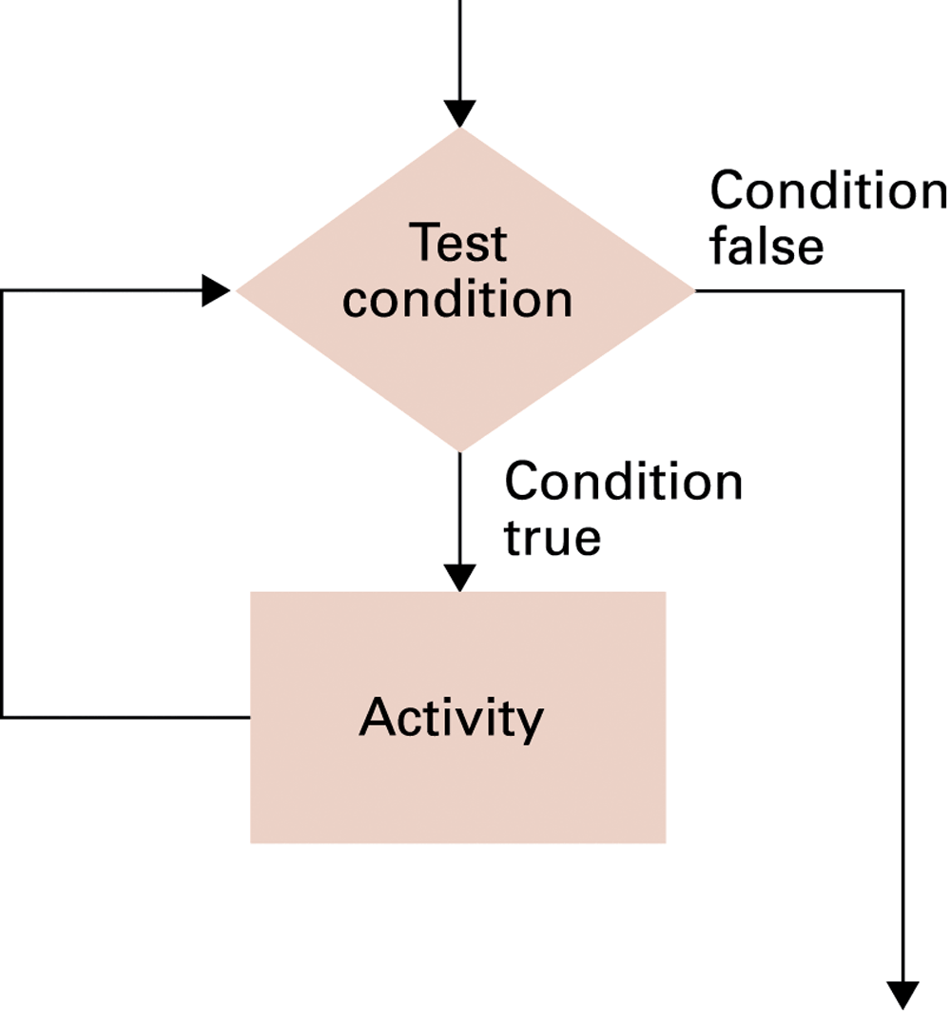
Figure 5.8 The while loop structure

Slide 16
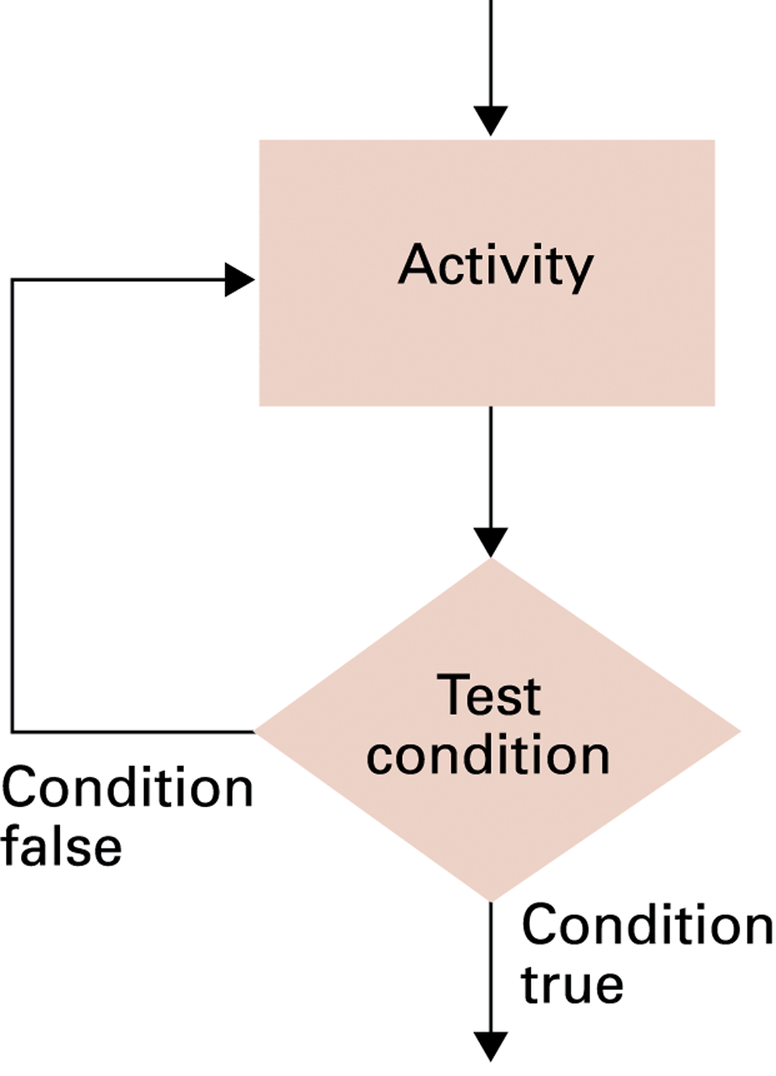
Figure 5.9 The repeat loop structure

Slide 17
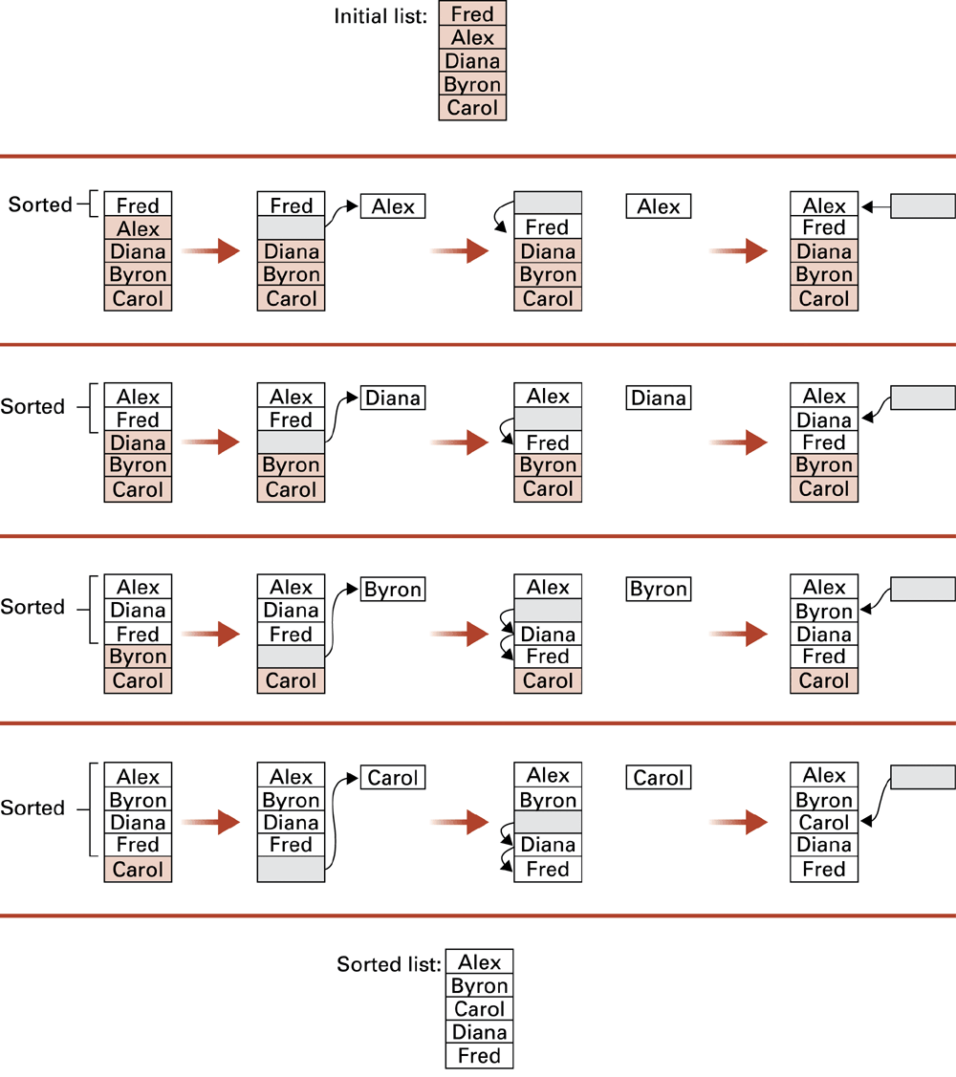
Figure 5.10 Sorting the list Fred, Alex, Diana, Byron, and Carol alphabetically

Slide 18
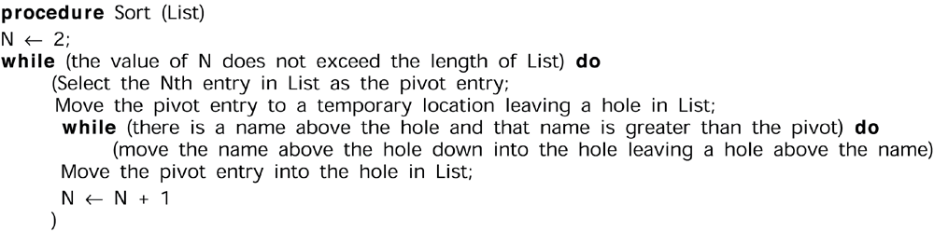
Figure 5.11 The insertion sort algorithm expressed in pseudocode

Slide 19
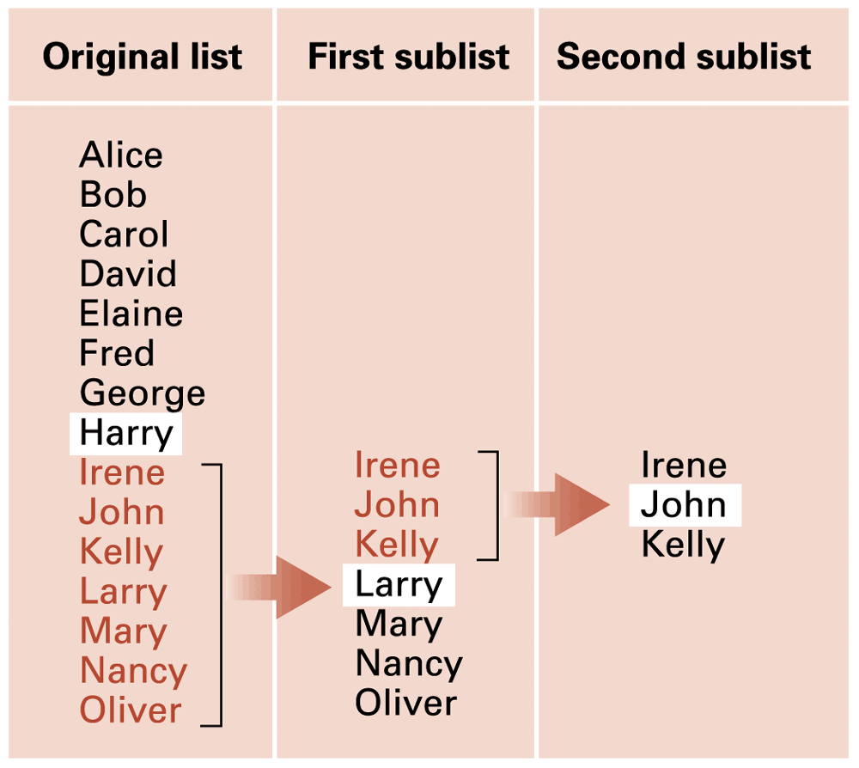
Figure 5.12 Applying our strategy to search a list for the entry John

Slide 20
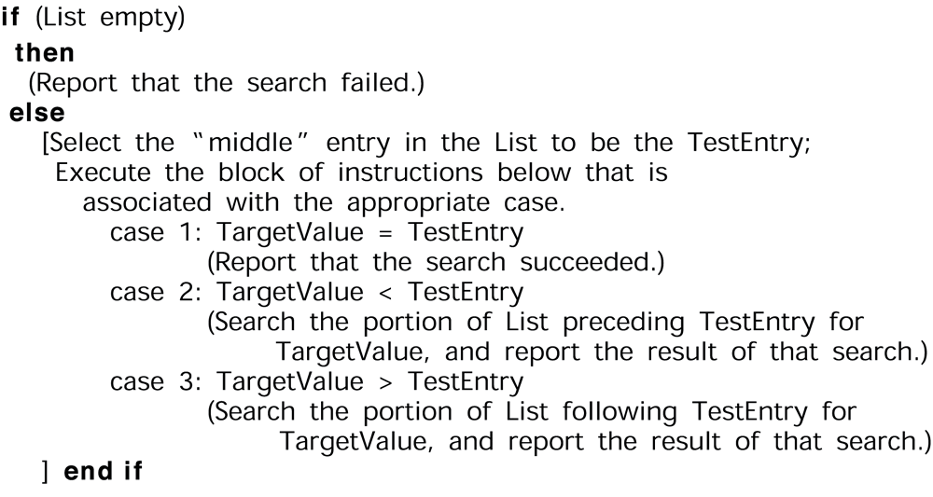
Figure 5.13 A first draft of the binary search technique

Slide 21
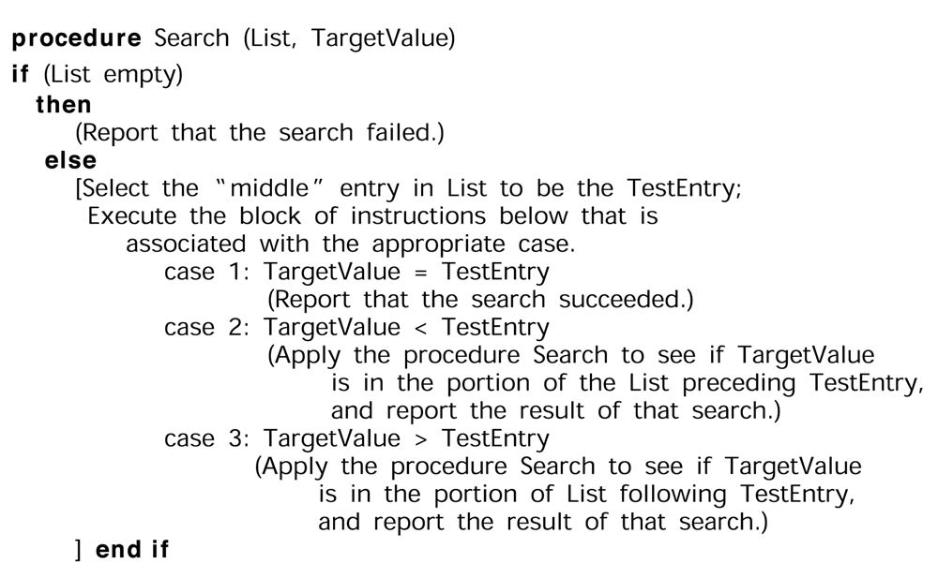
Figure 5.14 The binary search algorithm in pseudocode

Slide 22
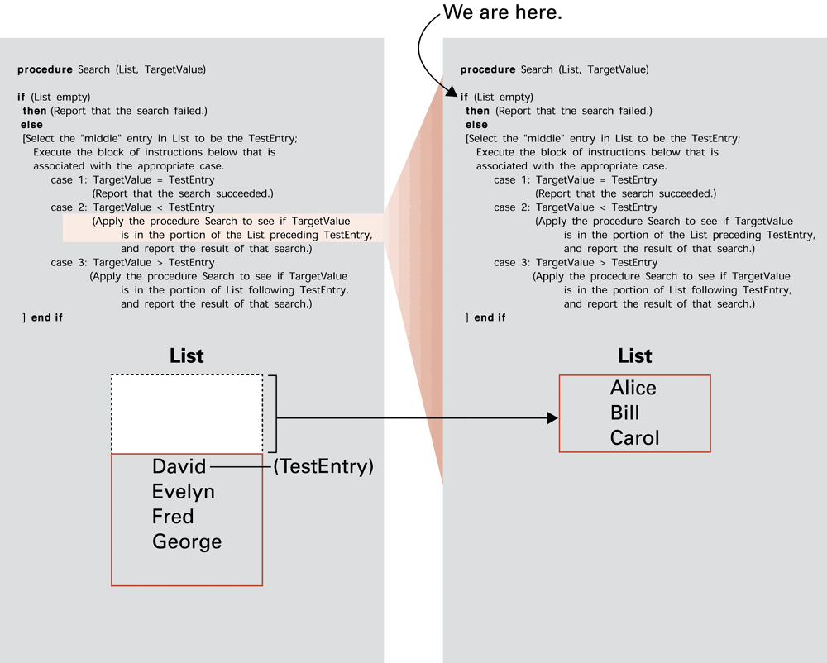
Figure 5.15

Slide 23
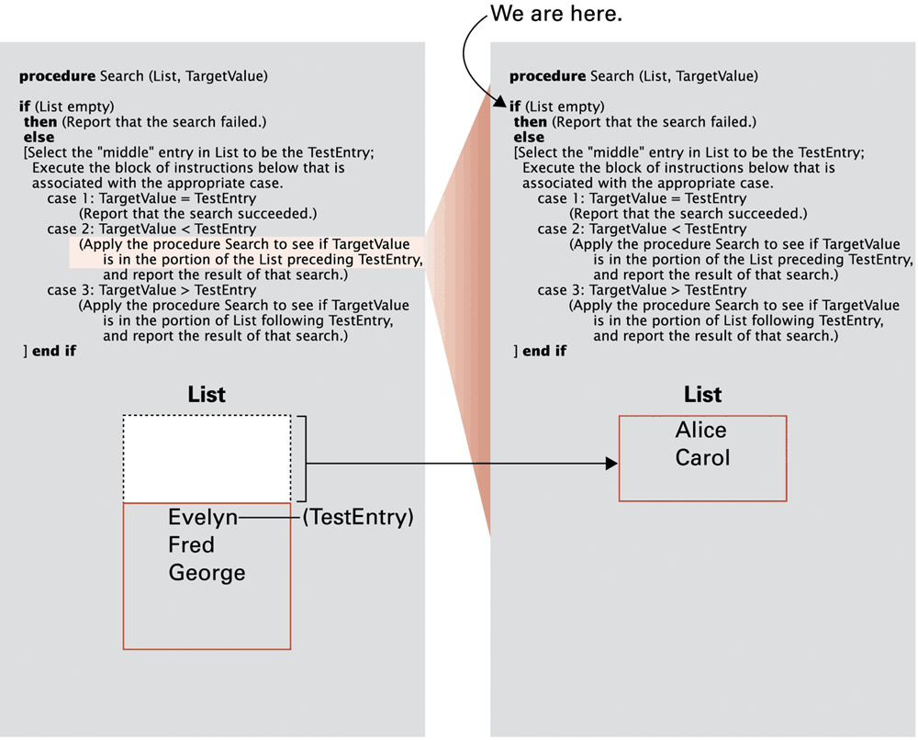
Figure 5.16

Slide 24
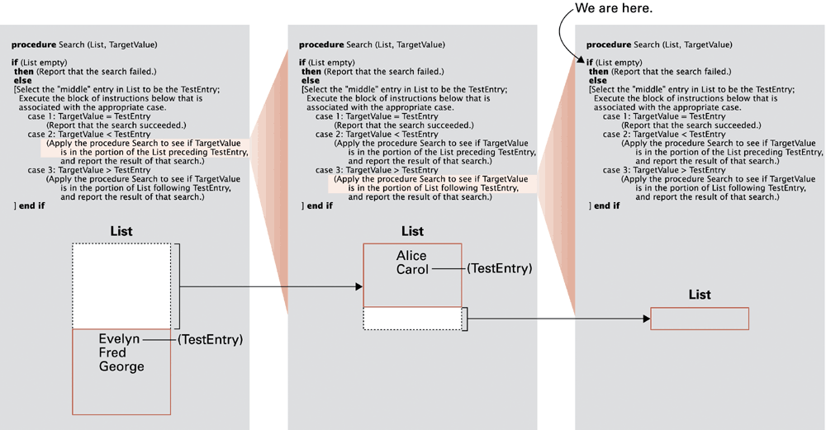
Figure 5.17

Slide 25
Software efficiency
Measured as number of instructions executed
Θ notation for efficiency classes
  Example: insertion sort is Θ(n²)
Best, worst, and average case

Slide 26
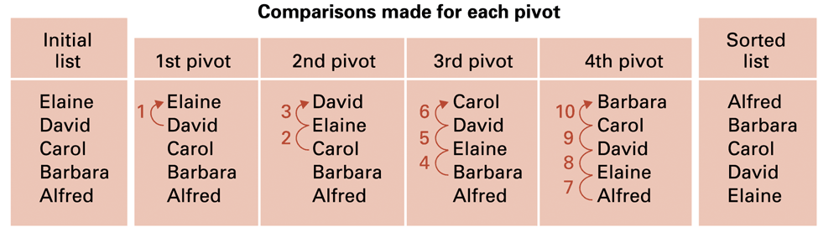
Figure 5.18 Applying the insertion sort in a worst-case situation

Slide 27
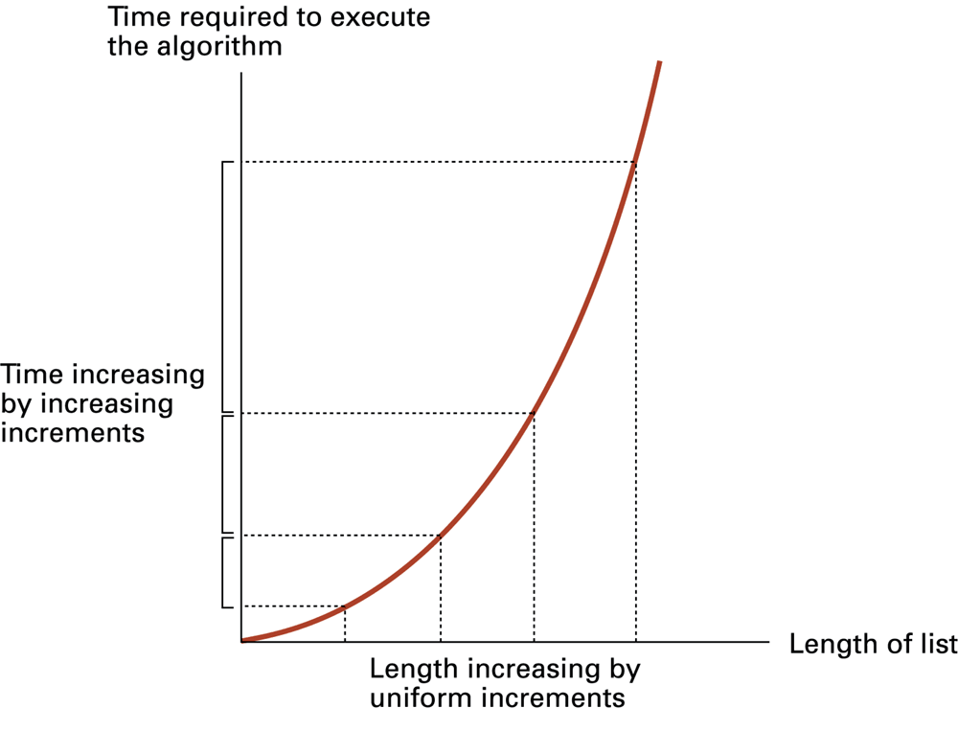
Figure 5.19 Graph of the worst-case analysis of the insertion sort algorithm

Slide 28
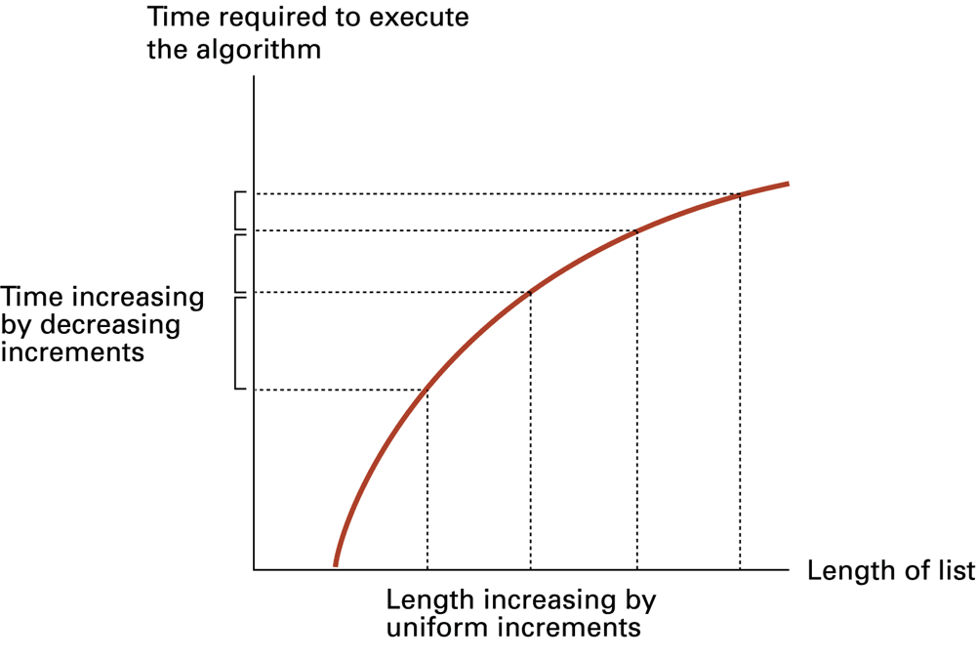
Figure 5.20 Graph of the worst-case analysis of the binary search algorithm

Slide 29
Software verification
Proof of correctness
  Assertions
    Preconditions
    Loop invariants
Testing

Slide 30
Example problem: Chain separating
A traveler has a gold chain of seven links.
He must stay at an isolated hotel for seven nights.
The rent each night consists of one link from the chain.
What is the fewest number of links that must be cut so that the traveler can pay the hotel one link of the chain each morning without paying for lodging in advance?

Slide 31
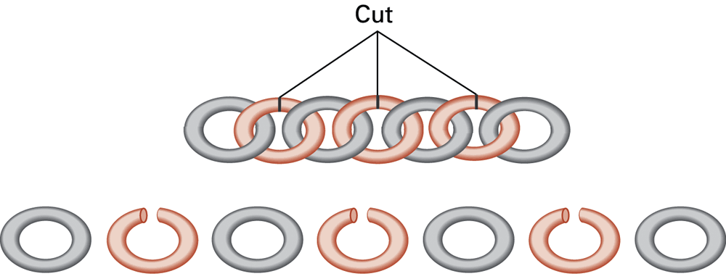
Figure 5.21 Separating the chain using only three cuts

Slide 32
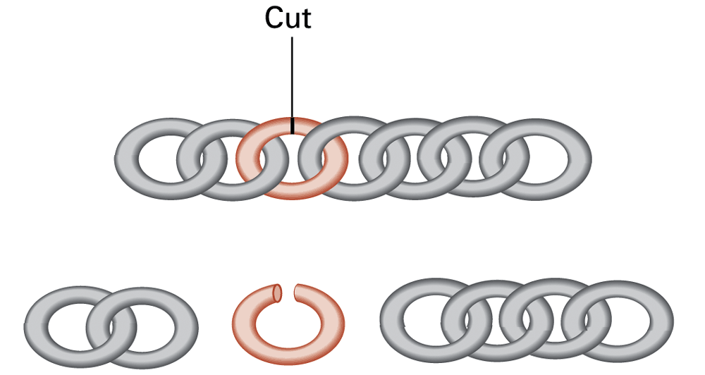
Figure 5.22 Solving the problem with only one cut

Slide 33
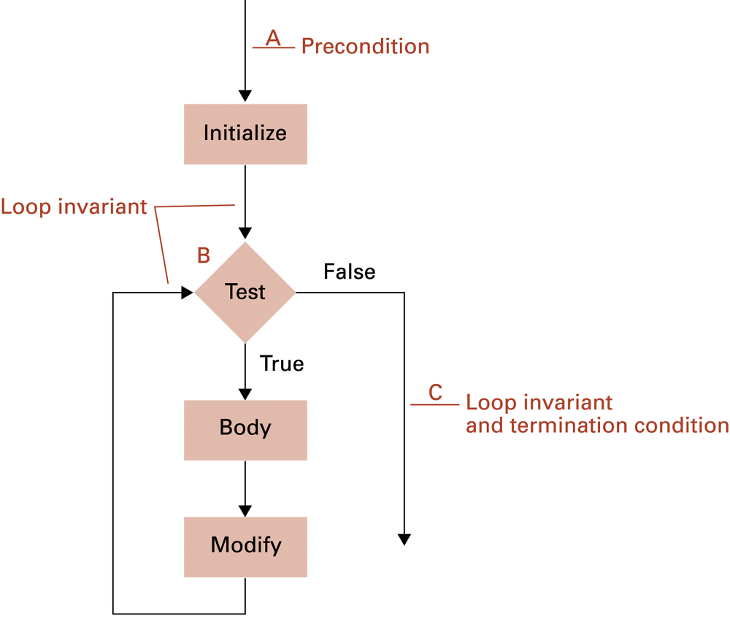
Figure 5.23 The assertions associated with a typical while structure

